Slide 1
Techorama
Lightning talk
Releasing to Azure using User Assigned Managed Identity Kinepolis Antwerp

Slide 2

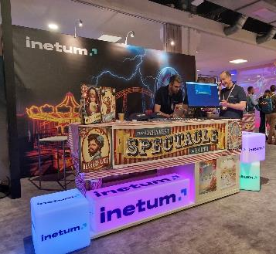


Hi, I am Jerry!
Active in IT since 2006
.NET Software Architect @ Inetum
Technical Lead DevOps-Team Zanzibar
Loves automating monkeyjobs
jerry.vanechelpoel@inetum-realdolmen.world
www.linkedin.com/in/jerryvanechelpoel

Slide 3
Context
01

Slide 4
Releasing software to Azure
Requires resources on Azure
Azure Key Vault
Storage Account
Web App Service
Azure Functions
…
Azure resources are protected
Access to resources needs to be granted to deploy software
App registration with the necessary permissions

Slide 5
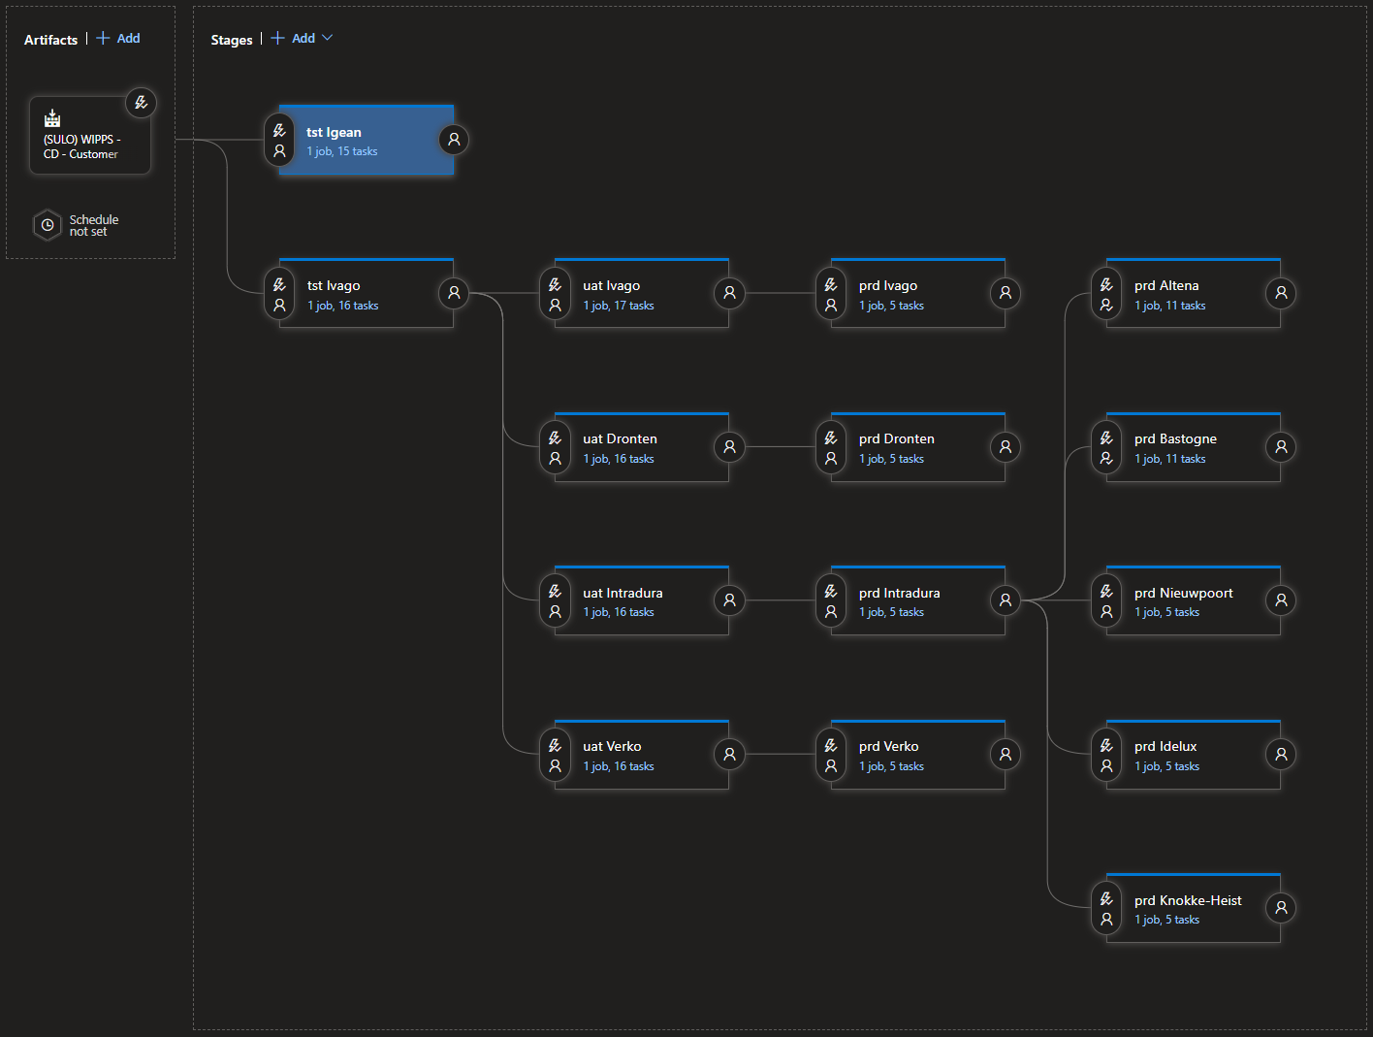
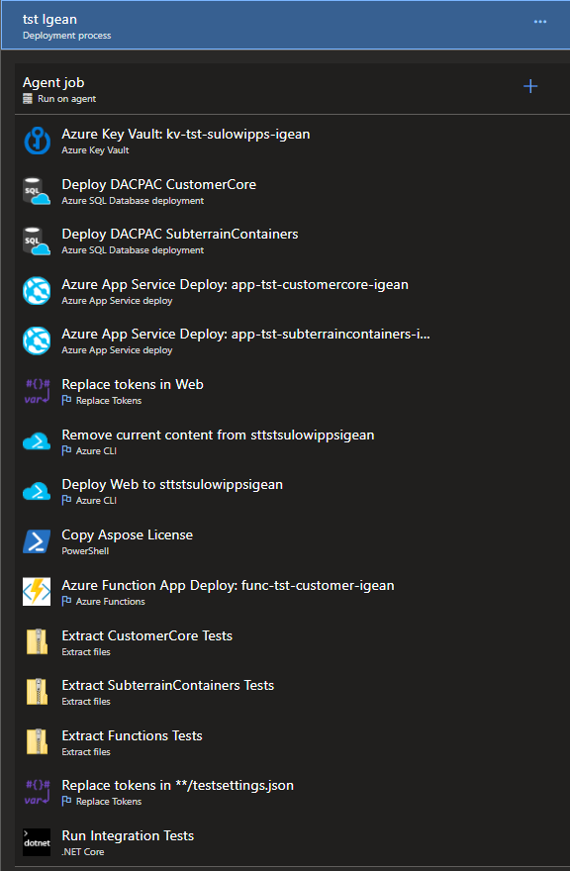
Example

Slide 6
The problem
App registrations are created through Entra ID
Not everyone can manage Entra ID
Application Developer role for restricted amount of users
Pollution of Entra ID
Multiple app registrations for different projects
Use of app registrations should be documented well
App registrations can be used for multiple resource groups
When compromised, all projects using the app registrations are impacted
Risk of using the wrong resources

Slide 7
Solution
02

Slide 8
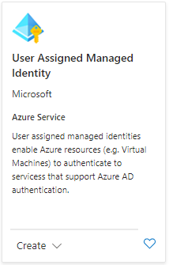
User Assigned Managed Identity
Azure resource
Can be created within the same resource group
Creates an app registration for you in Entra ID
Does not require Entra ID permissions
Easy set up
Allows fine-grained access to resources

Slide 9
How to use it?
03

Slide 10
Requirements
Azure DevOps
Permissions to create a service connection
Resource group
Contributor role

Slide 11
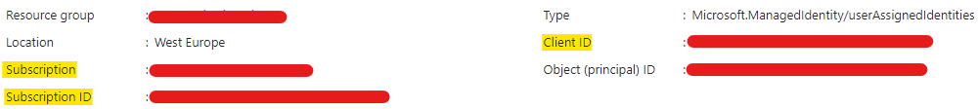
Set up User Assigned Managed Identity
Azure Portal (or Bicep)
User Assigned Managed Identity
Name (mi-…)
Add Federated credentials to User Assigned Managed Identity
Scenario: Other
Issuer URL (See service connection Azure DevOps)
Subject Identifier (See service connection Azure DevOps)
Name
Add contributor permissions to resources
Resource Group → Contributor (RBAC)
Azure Key Vault → Key Vault Reader (RBAC) or through Access Policies
Storage account → Storage Blob Data Contributor (RBAC)

Slide 12
Set up Service Connection
Azure DevOps
Create a new Service connection
Azure Resource Manager with Workload Identity federation (manual)
Set properties
SubscriptionId
Subscription Name
Service Principal ID (Client ID)
Tenant ID

Slide 13
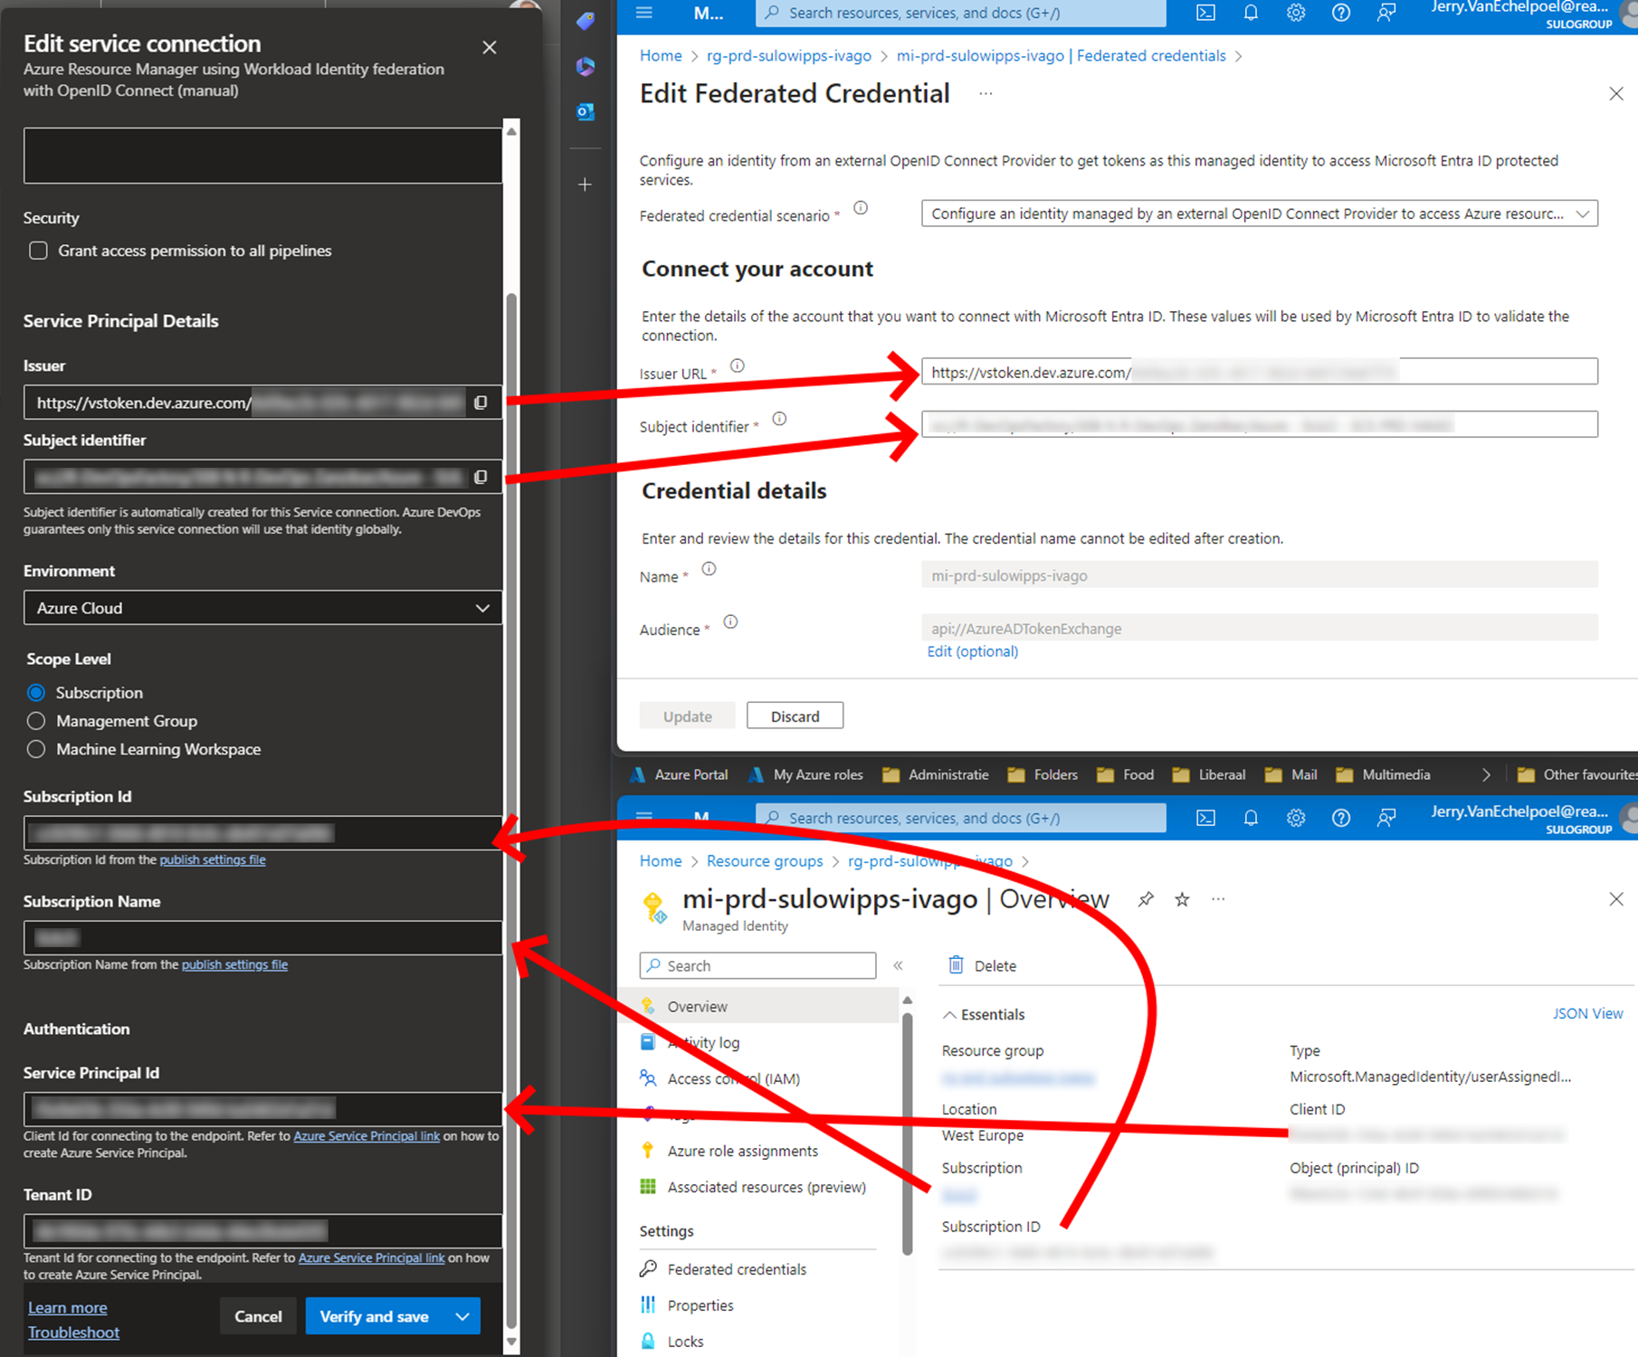

Slide 14
Conclusion
04

Slide 15
Key take-aways
No need for Entra ID permissions
Easy set up, easy to manage
Fine-grained access control

Slide 16
Q&A

